Slide 1





PICKLEBALL: Secure Deserialization of Pickle-based Machine Learning Models
Andreas D. Kellas¹, Neophytos Christou², Wenxin Jiang³, Penghui Li¹, Laurent Simon⁴, Yaniv David⁵, Vasileios P. Kemerlis², James C. Davis³, Junfeng Yang¹
1
2
3
4
5
Notes:
Intro:
I’m Andreas, a 5th year PhD student at Columbia University.
Today I am presenting PickleBall, a novel defense against pickle-based model backdoors.
This work was collaborative between teams at Columbia, Brown, Purdue, Google, and Technion.

Slide 2
Contributions
1. Study of model serialization formats in the Hugging Face model ecosystem.
2. Secure pickle model loading with library-specific policies.
3. Dataset of >300 malicious and benign pickle-based models and programs.
Notes:
In this work, we contribute:
A study of the open model ecosystem on Hugging Face, and of the model serialization formats that are used.
A system for securely loading pickle models, by generating policies specific to libraries, and enforcing the policies
A dataset of over 300 malicious and benign pickle-based models and pickle programs to evaluate solutions.

Slide 3




The Model Ecosystem Facilitates Model Sharing
The open model ecosystem lets engineers share and reuse pre-trained models.
Notes:
Today, training models is expensive. The open model ecosystem lets us save money and time by letting us share and reuse pre-trained models from large model hubs, like Hugging Face.
However, models from these hubs may come from untrusted sources. This lets attackers abuse this trust by creating malicious backdoored models and coercing users into loading them.
Backdoored models might be weights based, which compromise the inference of a model, or they can compromise the system that loads the models by executing arbitrary code.
This work focuses on backdoors that compromise the system.

Slide 4

The Model Ecosystem Facilitates Model Sharing
The open model ecosystem lets engineers share and reuse pre-trained models.
Models may come from untrusted sources, inviting security risks.
Notes:
Today, training models is expensive. The open model ecosystem lets us save money and time by letting us share and reuse pre-trained models from large model hubs, like Hugging Face.
However, models from these hubs may come from untrusted sources. This lets attackers abuse this trust by creating malicious backdoored models and coercing users into loading them.
Backdoored models might be weights based, which compromise the inference of a model, or they can compromise the system that loads the models by executing arbitrary code.
This work focuses on backdoors that compromise the system.

Slide 5
The Model Ecosystem Facilitates Model Sharing
The open model ecosystem lets engineers share and reuse pre-trained models.
Models may come from untrusted sources, inviting security risks.
Weights backdoors
System compromise backdoors
Notes:
Today, training models is expensive. The open model ecosystem lets us save money and time by letting us share and reuse pre-trained models from large model hubs, like Hugging Face.
However, models from these hubs may come from untrusted sources. This lets attackers abuse this trust by creating malicious backdoored models and coercing users into loading them.
Backdoored models might be weights based, which compromise the inference of a model, or they can compromise the system that loads the models by executing arbitrary code.
This work focuses on backdoors that compromise the system.

Slide 6
The Model Ecosystem Facilitates Model Sharing
The open model ecosystem lets engineers share and reuse pre-trained models.
Models may come from untrusted sources, inviting security risks.
Weights backdoors
System compromise backdoors
Focus of this work
Notes:
Today, training models is expensive. The open model ecosystem lets us save money and time by letting us share and reuse pre-trained models from large model hubs, like Hugging Face.
However, models from these hubs may come from untrusted sources. This lets attackers abuse this trust by creating malicious backdoored models and coercing users into loading them.
Backdoored models might be weights based, which compromise the inference of a model, or they can compromise the system that loads the models by executing arbitrary code.
This work focuses on backdoors that compromise the system.

Slide 7
Attackers Abuse Pickle-Based Models
Models are saved and loaded with serialization formats.
Notes:
Attackers abuse the model loading process, where a saved model is deserialized from a file into the program memory.
While many model serialization formats exist, like SafeTensors, GGUF, and others, the most widely abused is pickle. Almost all discovered backdoors abuse the pickle format.

Slide 8
Attackers Abuse Pickle-Based Models
Models are saved and loaded with serialization formats.
Attackers abuse the pickle format to create backdoored models.
Notes:
Attackers abuse the model loading process, where a saved model is deserialized from a file into the program memory.
While many model serialization formats exist, like SafeTensors, GGUF, and others, the most widely abused is pickle. Almost all discovered backdoors abuse the pickle format.

Slide 9
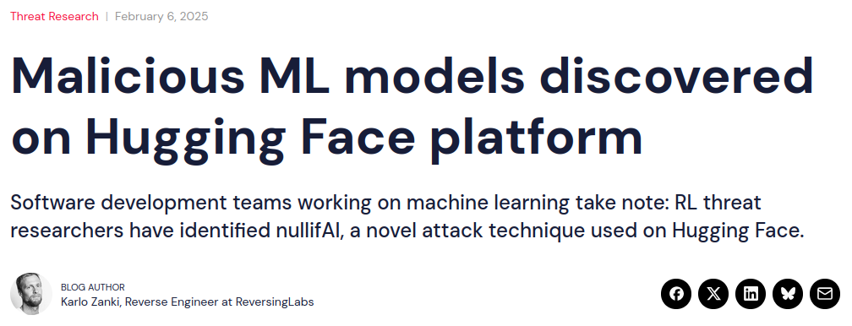
Attackers Abuse Pickle-Based Models
Models are saved and loaded with serialization formats.
Attackers abuse the pickle format to create backdoored models.
Notes:
Attackers abuse the model loading process, where a saved model is deserialized from a file into the program memory.
While many model serialization formats exist, like SafeTensors, GGUF, and others, the most widely abused is pickle. Almost all discovered backdoors abuse the pickle format.

Slide 10
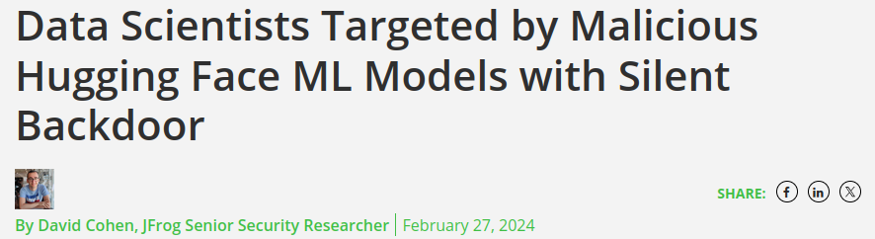
Attackers Abuse Pickle-Based Models
Models are saved and loaded with serialization formats.
Attackers abuse the pickle format to create backdoored models.
Notes:
Attackers abuse the model loading process, where a saved model is deserialized from a file into the program memory.
While many model serialization formats exist, like SafeTensors, GGUF, and others, the most widely abused is pickle. Almost all discovered backdoors abuse the pickle format.

Slide 11

Pickle is Easy to Abuse
The pickle format is (too) expressive:
Notes:
So, why do attackers abuse pickle? - Pickle is a very expressive format. Where other serialization formats may only encode the data in model weights and some information about operations, pickle models mix executable code and data.
Models that use the pickle format are encoded into a series of opcodes. When the model is loaded, these opcodes are executed by a virtual machine implemented in Python’s pickle module - called the “Pickle Machine”. When these opcodes execute, they instantiate the model as a python object and return it to the python program.
Most of the opcodes are very simple, but they expose functionality to import and invoke Python functions and class constructors (named “callables”). These are needed to construct complex data types like models, and load the weights values from disk.
These importing and invoking opcodes also give attackers an easy primitive to execute malicious callables – for example, by importing and calling functions like os.system.

Slide 12
Pickle is Easy to Abuse
The pickle format is (too) expressive:
Pickled objects are sequences of opcodes executed by the “Pickle Machine”.
Notes:
So, why do attackers abuse pickle? - Pickle is a very expressive format. Where other serialization formats may only encode the data in model weights and some information about operations, pickle models mix executable code and data.
Models that use the pickle format are encoded into a series of opcodes. When the model is loaded, these opcodes are executed by a virtual machine implemented in Python’s pickle module - called the “Pickle Machine”. When these opcodes execute, they instantiate the model as a python object and return it to the python program.
Most of the opcodes are very simple, but they expose functionality to import and invoke Python functions and class constructors (named “callables”). These are needed to construct complex data types like models, and load the weights values from disk.
These importing and invoking opcodes also give attackers an easy primitive to execute malicious callables – for example, by importing and calling functions like os.system.

Slide 13
Pickle is Easy to Abuse
The pickle format is (too) expressive:
Pickled objects are sequences of opcodes executed by the “Pickle Machine”.
Opcodes can import and invoke Python callables (functions or classes).
IMPORT torch.FloatStorage
CREATE torch.FloatStorage.__new__
IMPORT torch.rebuild_tensor_v2 INVOKE torch.rebuild_tensor_v2(...)
Notes:
So, why do attackers abuse pickle? - Pickle is a very expressive format. Where other serialization formats may only encode the data in model weights and some information about operations, pickle models mix executable code and data.
Models that use the pickle format are encoded into a series of opcodes. When the model is loaded, these opcodes are executed by a virtual machine implemented in Python’s pickle module - called the “Pickle Machine”. When these opcodes execute, they instantiate the model as a python object and return it to the python program.
Most of the opcodes are very simple, but they expose functionality to import and invoke Python functions and class constructors (named “callables”). These are needed to construct complex data types like models, and load the weights values from disk.
These importing and invoking opcodes also give attackers an easy primitive to execute malicious callables – for example, by importing and calling functions like os.system.

Slide 14
Pickle is Easy to Abuse
The pickle format is (too) expressive:
Pickled objects are sequences of opcodes executed by the “Pickle Machine”.
Opcodes can import and invoke Python callables (functions or classes).
Attackers can trivially import and invoke malicious callables, like os.system.
IMPORT torch.FloatStorage
CREATE torch.FloatStorage.__new__
IMPORT torch.rebuild_tensor_v2 INVOKE torch.rebuild_tensor_v2(...) IMPORT os.system INVOKE os.system(‘nc -lp 1337 -e /bin/bash’)
Notes:
So, why do attackers abuse pickle? - Pickle is a very expressive format. Where other serialization formats may only encode the data in model weights and some information about operations, pickle models mix executable code and data.
Models that use the pickle format are encoded into a series of opcodes. When the model is loaded, these opcodes are executed by a virtual machine implemented in Python’s pickle module - called the “Pickle Machine”. When these opcodes execute, they instantiate the model as a python object and return it to the python program.
Most of the opcodes are very simple, but they expose functionality to import and invoke Python functions and class constructors (named “callables”). These are needed to construct complex data types like models, and load the weights values from disk.
These importing and invoking opcodes also give attackers an easy primitive to execute malicious callables – for example, by importing and calling functions like os.system.

Slide 15
Existing ML Pickle Security Solutions
Source: https://docs.python.org/3/library/pickle.html
Notes:
The dangers of pickle are known. Official Python documentation warns users not to deserialization untrusted data.
To protect the ML mode loading problem, we have some existing defenses:
Alternate formats, like Hugging Face’s SafeTensors, are recommended over pickle. These formats are less expressive, and typically only encode weight values.
Model scanners are used to analyze models …
Restricted loaders …

Slide 16



Existing ML Pickle Security Solutions
Alternate formats with less expressive representations are recommended.
SafeTensors was designed for security.
Notes:
The dangers of pickle are known. Official Python documentation warns users not to deserialization untrusted data.
To protect the ML mode loading problem, we have some existing defenses:
Alternate formats, like Hugging Face’s SafeTensors, are recommended over pickle. These formats are less expressive, and typically only encode weight values.
Model scanners are used to analyze models …
Restricted loaders …

Slide 17

Existing ML Pickle Security Solutions
Alternate formats with less expressive representations are recommended.
SafeTensors was designed for security.
Model scanners analyze models to identify unsafe callables applying a denylist.
Hugging Face deploys multiple model scanners, but policies are incomplete.
Notes:
The dangers of pickle are known. Official Python documentation warns users not to deserialization untrusted data.
To protect the ML mode loading problem, we have some existing defenses:
Alternate formats, like Hugging Face’s SafeTensors, are recommended over pickle. These formats are less expressive, and typically only encode weight values.
Model scanners are used to analyze models …
Restricted loaders …

Slide 18

Existing ML Pickle Security Solutions
Alternate formats with less expressive representations are recommended.
SafeTensors was designed for security.
Model scanners analyze models to identify unsafe callables applying a denylist.
Hugging Face deploys multiple model scanners, but policies are incomplete.
Restricted loaders only permit safe callables with restrictive allowlist.
The Weights Only Unpickler is default in PyTorch 2.6.
Notes:
The dangers of pickle are known. Official Python documentation warns users not to deserialization untrusted data.
To protect the ML mode loading problem, we have some existing defenses:
Alternate formats, like Hugging Face’s SafeTensors, are recommended over pickle. These formats are less expressive, and typically only encode weight values.
Model scanners are used to analyze models …
Restricted loaders …

Slide 19
Open Questions
Q1: Is this a problem?
Q2: How do we fix it?
Notes:
This raised the question: are pickle models still used in the model ecosystem? Are the existing defenses, like alternate formats and restricted loaders, sufficient?

Slide 20
Empirical Study
Are pickle models used, despite alternative formats?
Hugging Face longitudinal study: ~2 year period (January 2023 – March 2025)
Finding: pickle downloads are increasing (2.1 billion monthly downloads)
Notes:
To answer this, we conducted a longitudinal study of the model ecosystem by analyzing models on Huggging Face over a two year period. We found that despite alternate formats, the number of pickle model downloads is actually increasing, with over 2.1 billion monthly downloads in the last month of the study, up from ~500 million in the first.

Slide 21
Empirical Study
Are pickle models used, despite alternative formats?
Hugging Face longitudinal study: ~2 year period (January 2023 – March 2025)
Finding: pickle downloads are increasing (2.1 billion monthly downloads)
Can the Weights Only Unpickler load existing pickle models?
Traced pickle models in study
Finding: among repositories with pickle models, 15% contain pickle model that cannot be loaded by Weights Only Unpickler
Notes:
We then sampled models from our study to determine whether they could be loaded by the Weights Only Unpickler, and found that 15% of sampled repositories had models that could not be loaded - indicating a usability problem with the weights only unpickler.

Slide 22
Open Questions
Q1: Is this a problem?
Q2: How do we fix it?
Notes:
So, we recognized that pickle model loading is still a security problem.

Slide 23
Open Questions
Q1: Is this a problem?
Q2: How do we fix it?
Notes:
We asked, how can we design a system to fix it?

Slide 24
Goal
Requirement: prevent malicious models from executing unnecessary callables, but permit benign models to use callables necessary to load model.
Design goal: We aim to prioritize security by blocking malicious models, but improve usability by loading more benign models without user intervention.
Insight: We can make context-specific loading policies, rather than one-size-fits all.
Notes:
To solve the continuing Pickle security problem and to account for the limitations of existing approaches, we recognize the need for solution that prevents malicious models from executing unnecessary callables, while still permitting benign models to access the callables they need.
We want to prioritize security, to block all or as many malicious models as possible, while increasing usability of the system to correctly load more benign models.
Rather than using one-size-fits-all approaches, we want to achieve our usability goals with context specific loading policies.

Slide 25
Insight: Libraries Provide Trusted Specifications
Model Saver
Model Loader
from lib import Model, train
model = Model()
train(model, corpus)
model.save(‘model.bin’)
from lib import Model, train
model = Model.load(‘model.bin’)
model.predict(input)
Notes:
The insight to our approach is that ML libraries are a shared interface between model saving applications and model loading applications.
Engineers use libraries to create and save models - these provide utility functions for training and interacting with models.

Slide 26
Insight: Libraries Provide Trusted Specifications
Model Saver
Model Loader
from lib import Model, train
model = Model()
train(model, corpus)
model.save(‘model.bin’)
from lib import Model, train
model = Model.load(‘model.bin’)
model.predict(input)
Imports:
lib.Model
torch.Tensor
lib.read_weights_from_file
lib.SGD
Notes:
The engineer will use a library API to create and save a model. If it’s a pickle model, it will have some callables encoded in its representation.

Slide 27
Insight: Libraries Provide Trusted Specifications
Model Saver
Model Loader
from lib import Model, train
model = Model()
train(model, corpus)
model.save(‘model.bin’)
from lib import Model, train
model = Model.load(‘model.bin’)
model.predict(input)
Imports:
lib.Model
torch.Tensor
lib.read_weights_from_file
lib.SGD
Notes:
To load a model, the user has to use the model loading API from the same library. Once loaded, the library provides an API for interacting with the model, like prediction tasks.

Slide 28
Insight: Libraries Provide Trusted Specifications
Model Saver
Model Loader
from lib import Model, train
model = Model()
train(model, corpus)
model.save(‘model.bin’)
from lib import Model, train
model = Model.load(‘model.bin’)
model.predict(input)
Q: Should a Model need to import these callables?
Imports:
lib.Model
torch.Tensor
lib.read_weights_from_file
lib.SGD
Notes:
Given a model, should it have the imports that it does, or were they placed there maliciously?

Slide 29
Insight: Libraries Provide Trusted Specifications
Model Saver
Model Loader
from lib import Model, train
model = Model()
train(model, corpus)
model.save(‘model.bin’)
from lib import Model, train
model = Model.load(‘model.bin’)
model.predict(input)
Q: Should a Model need to import these callables?
Imports:
lib.Model
torch.Tensor
lib.read_weights_from_file
lib.SGD
Notes:
When determining this, the user of the model does not have access to the program that created the model.

Slide 30
Insight: Libraries Provide Trusted Specifications
Model Saver
Model Loader
from lib import Model, train
model = Model()
train(model, corpus)
model.save(‘model.bin’)
from lib import Model, train
model = Model.load(‘model.bin’)
model.predict(input)
Q: Should a Model need to import these callables?
Imports:
lib.Model
torch.Tensor
lib.read_weights_from_file
lib.SGD
A: We can look at the Model class definition.
Notes:
But the user does know the library API that they need to load the model, and which allegedly created the model.

Slide 31
Insight: Libraries Provide Trusted Specifications
Model Saver
Model Loader
from lib import Model, train
model = Model()
train(model, corpus)
model.save(‘model.bin’)
from lib import Model, train
model = Model.load(‘model.bin’)
model.predict(input)
class Model(object):
def __init__(self, weights: Tensor):
self.weights = weights
class Tensor(object):
def __reduce__(self):
return (read_weights_to_tensor, (self.filename,))
def read_weights_to_tensor(filename: str) -> Tensor:
# Read a weights file and return a Tensor
Q: Should a Model need to import these callables?
Imports:
lib.Model
torch.Tensor
lib.read_weights_from_file
lib.GradDescent
A: We can look at the Model class definition.
Notes:
We can use the library Model class definition as a specification: we can look to it for evidence of callables that could appear in a model if the library was used to create the model.

Slide 32
Insight: Libraries Provide Trusted Specifications
Model Saver
Model Loader
from lib import Model, train
model = Model()
train(model, corpus)
model.save(‘model.bin’)
from lib import Model, train
model = Model.load(‘model.bin’)
model.predict(input)
class Model(object):
def __init__(self, weights: Tensor):
self.weights = weights
class Tensor(object):
def __reduce__(self):
return (read_weights_to_tensor, (self.filename,))
def read_weights_to_tensor(filename: str) -> Tensor:
# Read a weights file and return a Tensor
Q: Should a Model need to import these callables?
Imports:
lib.Model
torch.Tensor
lib.read_weights_from_file
lib.GradDescent
A: We can look at the Model class definition.
Notes:
We can use the library Model class definition as a specification: we can look to it for evidence of callables that could appear in a model if the library was used to create the model.
Models that are created by other APIs or programs, including malicious ones, should not fit this specification.

Slide 33
PICKLEBALL: Overview
Pickle Model
Library Code
PickleBall
Policy Generation Static Analysis
Policy Enforcement
Restricted Loader
Loaded Model
lib.py
lib.py
lib.py
OR
Loading Policy
Security Exception
Model Class Definition
Notes:
Using this insight, we designed and implemented PickleBall, a novel approach to securely load pickle models.
PickleBall applies the standard pattern of applying static program analysis to generate a policy, which is enforced during runtime. PickleBall specializes this pattern to account for specific ML and pickle challenges.
PickleBall is implemented in two components:
First, policy generation: PickleBall statically analyzes the model class definition in the library source code to create a loading policy that is specific to the library.
Then, when a model needs to be loaded using the library, PickleBall enforces the policy. At the end of the model loading, PickleBall either returns the loaded model as a Python object, or raises a security exception.

Slide 34
PICKLEBALL: Policy Generation
A loading policy represents all callables that could appear in any pickle program encoding a valid model.
Notes:
When PickleBall generates a loading policy for a library, the policy is meant to represent all the callables that could appear in a pickle program that represents a valid model from the library.

Slide 35
PICKLEBALL: Policy Generation
A loading policy represents all callables that could appear in any pickle program encoding a valid model.
Python library source code
Generated loading policy
class Model(object):
def __init__(self, weights: Tensor):
self.weights = weights
class Tensor(object):
def __reduce__(self):
return (read_weights_to_tensor, (self.filename,))
def read_weights_to_tensor(filename: str) -> Tensor:
# Read a weights file and return a Tensor
Allowed Imports:
Allowed Invocations:
Notes:
PickleBall statically analyzes the library model class definition to generate the policy.

Slide 36
PICKLEBALL: Policy Generation
A loading policy represents all callables that could appear in any pickle program encoding a valid model.
Python library source code
Generated loading policy
class Model(object):
def __init__(self, weights: Tensor):
self.weights = weights
class Tensor(object):
def __reduce__(self):
return (read_weights_to_tensor, (self.filename,))
def read_weights_to_tensor(filename: str) -> Tensor:
# Read a weights file and return a Tensor
Allowed Imports:
Model
Allowed Invocations:
Notes:
For a high-level summary:
PickleBall begins at the model class definition …

Slide 37
PICKLEBALL: Policy Generation
A loading policy represents all callables that could appear in any pickle program encoding a valid model.
Python library source code
Generated loading policy
class Model(object):
def __init__(self, weights: Tensor):
self.weights = weights
class Tensor(object):
def __reduce__(self):
return (read_weights_to_tensor, (self.filename,))
def read_weights_to_tensor(filename: str) -> Tensor:
# Read a weights file and return a Tensor
Allowed Imports:
Model
Allowed Invocations:
Notes:
… and identifies what other class types are needed to instantiate a model object, based on its attribute types.

Slide 38
PICKLEBALL: Policy Generation
A loading policy represents all callables that could appear in any pickle program encoding a valid model.
Python library source code
Generated loading policy
class Model(object):
def __init__(self, weights: Tensor):
self.weights = weights
class Tensor(object):
def __reduce__(self):
return (read_weights_to_tensor, (self.filename,))
def read_weights_to_tensor(filename: str) -> Tensor:
# Read a weights file and return a Tensor
Allowed Imports:
Model
Allowed Invocations:
Notes:
It recursively visits those types, and applies rules based on a mapping of how pickle serializes python objects, accounting for methods with special semantics for pickle, like the __reduce__ method. Its rules determine when a callable is allowed to just be imported and instantiated, or also invoked.

Slide 39
PICKLEBALL: Policy Generation
A loading policy represents all callables that could appear in any pickle program encoding a valid model.
Python library source code
Generated loading policy
class Model(object):
def __init__(self, weights: Tensor):
self.weights = weights
class Tensor(object):
def __reduce__(self):
return (read_weights_to_tensor, (self.filename,))
def read_weights_to_tensor(filename: str) -> Tensor:
# Read a weights file and return a Tensor
Allowed Imports:
Model
read_weights_to_tensor
Allowed Invocations:
read_weights_to_tensor

Slide 40
Overcoming Python Analysis Challenges
Challenge: Python is a dynamic language but policies are generated statically.
Issue | Mitigation
Notes:
Python is a dynamic language, which makes static analysis challenging. PickleBall’s policy generation is limited by some of these challenges, which it partially mitigates with its implementation.
First, missing path information can result in missing types and incomplete policies. PickleBall mitigates this with a lazy policy enforcement, that allows model loading to continue when a missing callable remains unaccessed or uninvoked. This is helpful in the ML context, where PickleBall may miss type information that represents how the model was trained after it is instantiated. If the these callables are not used during loading or inference, PickleBall skips them and continues loading.
To account for loose policies that result form over-approximate type recovery, PickleBall separates its policies into allowed imports and allowed invocations, and only adds callables to the allowed invocations when there is strong evidence that the callable needs to be invoked.
For more detailed discussion of these limitations and mitigations, I invite you to read our paper.

Slide 41
Overcoming Python Analysis Challenges
Challenge: Python is a dynamic language but policies are generated statically.
Issue | Mitigation
Incomplete path analysis of the model creating program → missing types and incomplete policies. | PickleBall is robust to missing but unused callables through lazy enforcement.
Notes:
Python is a dynamic language, which makes static analysis challenging. PickleBall’s policy generation is limited by some of these challenges, which it partially mitigates with its implementation.
First, missing path information can result in missing types and incomplete policies. PickleBall mitigates this with a lazy policy enforcement, that allows model loading to continue when a missing callable remains unaccessed or uninvoked. This is helpful in the ML context, where PickleBall may miss type information that represents how the model was trained after it is instantiated. If the these callables are not used during loading or inference, PickleBall skips them and continues loading.
To account for loose policies that result form over-approximate type recovery, PickleBall separates its policies into allowed imports and allowed invocations, and only adds callables to the allowed invocations when there is strong evidence that the callable needs to be invoked.
For more detailed discussion of these limitations and mitigations, I invite you to read our paper.

Slide 42
Overcoming Python Analysis Challenges
Challenge: Python is a dynamic language but policies are generated statically.
Issue | Mitigation
Incomplete path analysis of the model creating program → missing types and incomplete policies. | PickleBall is robust to missing but unused callables through lazy enforcement.
Leverages pattern in ML models.
Notes:
Python is a dynamic language, which makes static analysis challenging. PickleBall’s policy generation is limited by some of these challenges, which it partially mitigates with its implementation.
First, missing path information can result in missing types and incomplete policies. PickleBall mitigates this with a lazy policy enforcement, that allows model loading to continue when a missing callable remains unaccessed or uninvoked. This is helpful in the ML context, where PickleBall may miss type information that represents how the model was trained after it is instantiated. If the these callables are not used during loading or inference, PickleBall skips them and continues loading.
To account for loose policies that result form over-approximate type recovery, PickleBall separates its policies into allowed imports and allowed invocations, and only adds callables to the allowed invocations when there is strong evidence that the callable needs to be invoked.
For more detailed discussion of these limitations and mitigations, I invite you to read our paper.

Slide 43
Overcoming Python Analysis Challenges
Challenge: Python is a dynamic language but policies are generated statically.
Issue | Mitigation
Incomplete path analysis of the model creating program → missing types and incomplete policies. | PickleBall is robust to missing but unused callables through lazy enforcement.
Over-approximate type recovery → loose policies. | PickleBall separates allowed imports from allowed invocations.
Leverages pattern in ML models.
Notes:
Python is a dynamic language, which makes static analysis challenging. PickleBall’s policy generation is limited by some of these challenges, which it partially mitigates with its implementation.
First, missing path information can result in missing types and incomplete policies. PickleBall mitigates this with a lazy policy enforcement, that allows model loading to continue when a missing callable remains unaccessed or uninvoked. This is helpful in the ML context, where PickleBall may miss type information that represents how the model was trained after it is instantiated. If the these callables are not used during loading or inference, PickleBall skips them and continues loading.
To account for loose policies that result form over-approximate type recovery, PickleBall separates its policies into allowed imports and allowed invocations, and only adds callables to the allowed invocations when there is strong evidence that the callable needs to be invoked.
For more detailed discussion of these limitations and mitigations, I invite you to read our paper.

Slide 44
Overcoming Python Analysis Challenges
Challenge: Python is a dynamic language but policies are generated statically.
Issue | Mitigation
Incomplete path analysis of the model creating program → missing types and incomplete policies. | PickleBall is robust to missing but unused callables through lazy enforcement.
Over-approximate type recovery → loose policies. | PickleBall separates allowed imports from allowed invocations.
Leverages pattern in ML models.
Inspired by analysis of insecure pickle implementations.
Notes:
Python is a dynamic language, which makes static analysis challenging. PickleBall’s policy generation is limited by some of these challenges, which it partially mitigates with its implementation.
First, missing path information can result in missing types and incomplete policies. PickleBall mitigates this with a lazy policy enforcement, that allows model loading to continue when a missing callable remains unaccessed or uninvoked. This is helpful in the ML context, where PickleBall may miss type information that represents how the model was trained after it is instantiated. If the these callables are not used during loading or inference, PickleBall skips them and continues loading.
To account for loose policies that result form over-approximate type recovery, PickleBall separates its policies into allowed imports and allowed invocations, and only adds callables to the allowed invocations when there is strong evidence that the callable needs to be invoked.
For more detailed discussion of these limitations and mitigations, I invite you to read our paper.

Slide 45
Evaluation: A Rigorous Dataset
Notes:
To evaluate PickleBall, we constructed a dataset of libraries and models.

Slide 46

Evaluation: A Rigorous Dataset
16 ML Libraries that load pickle models.
Represent the at-risk APIs that are compromised by malicious pickle models and need to be protected with policies.
Notes:
To evaluate PickleBall, we constructed a dataset of libraries and models.

Slide 47
Evaluation: A Rigorous Dataset
16 ML Libraries that load pickle models.
Represent the at-risk APIs that are compromised by malicious pickle models and need to be protected with policies.
84 malicious models and pickle programs.
Represent all known techniques used by malicious pickle models.
Notes:
To evaluate PickleBall, we constructed a dataset of libraries and models.

Slide 48
Evaluation: A Rigorous Dataset
16 ML Libraries that load pickle models.
Represent the at-risk APIs that are compromised by malicious pickle models and need to be protected with policies.
84 malicious models and pickle programs.
Represent all known techniques used by malicious pickle models.
252 benign models.
Represent all known techniques used by malicious pickle models.
Notes:
To evaluate PickleBall, we needed a comprehensive dataset of libraries and models.
We built a set of 16 libraries, which represent the APIs used to create pickle models and to load pickle models. We searched huggingface for popular pickle-based models and identified the library needed to load the model. Most of the libraries extend foundational libraries like pytorch and transformers. - [Optional - decide]: We exclude these foundational libraries because they do not produce pickle models with abnormal imports and do not have insecure loading APIs.
We created a set of 84 malicious pickle models and pickle programs. They represent all known techniques used by malicious models. It is collected from existing work that scanned all models on hugging face, and we check that its contents are representative of the models described in security reporting. We also supplemented it with two models with techniques that we found to bypass existing scanners, which we disclosed to the affected vendors.
We created a set of 252 benign pickle models. They represent the models that should be loaded without inconveniencing users. We identified models associated with each of the 16 libraries by querying Hugging Face for the libraries and their loading APIs, and filter by number of downloads.

Slide 49
Evaluation: PICKLEBALL Creates Secure and Usable Policies
PICKLEBALL is compared to State of the Art solutions.
Tool | Type
ProtectAI ModelScan | Scanner
ModelTracer | Scanner
Weights-Only Unpickler | Restricted Loader
PICKLEBALL | Restricted Loader
Notes:
We compare PickleBall to state of the art tools that use diverse techniques.
ProtectAI’s ModelScan is a scanner integrated into the Hugging Face platform today to analyze models when they are uploaded to the platform. It is representative of static analysis scanners.
ModelTracer is a dynamic scanner that traces the model during loading and analyzes the trace of system calls invoked during loading. It is the only application we know of that uses dynamic tracing to analyze models.
The Weights-Only Unpickler is the default pickle loader in PyTorch, today.

Slide 50
Evaluation: PICKLEBALL Creates Secure and Usable Policies
PICKLEBALL is compared to State of the Art solutions.
Tool | Type
ProtectAI ModelScan | Scanner
ModelTracer | Scanner
Weights-Only Unpickler | Restricted Loader
PICKLEBALL | Restricted Loader
Static analysis tool integrated on Hugging Face.
Notes:
We compare PickleBall to state of the art tools that use diverse techniques.
ProtectAI’s ModelScan is a scanner integrated into the Hugging Face platform today to analyze models when they are uploaded to the platform. It is representative of static analysis scanners.
ModelTracer is a dynamic scanner that traces the model during loading and analyzes the trace of system calls invoked during loading. It is the only application we know of that uses dynamic tracing to analyze models.
The Weights-Only Unpickler is the default pickle loader in PyTorch, today.

Slide 51
Evaluation: PICKLEBALL Creates Secure and Usable Policies
PICKLEBALL is compared to State of the Art solutions.
Tool | Type
ProtectAI ModelScan | Scanner
ModelTracer | Scanner
Weights-Only Unpickler | Restricted Loader
PICKLEBALL | Restricted Loader
Static analysis tool integrated on Hugging Face.
Dynamic tracing tool proposed by Casey et al. [13].
Notes:
We compare PickleBall to state of the art tools that use diverse techniques.
ProtectAI’s ModelScan is a scanner integrated into the Hugging Face platform today to analyze models when they are uploaded to the platform. It is representative of static analysis scanners.
ModelTracer is a dynamic scanner that traces the model during loading and analyzes the trace of system calls invoked during loading. It is the only application we know of that uses dynamic tracing to analyze models.
The Weights-Only Unpickler is the default pickle loader in PyTorch, today.

Slide 52
Evaluation: PICKLEBALL Creates Secure and Usable Policies
PICKLEBALL is compared to State of the Art solutions.
Tool | Type
ProtectAI ModelScan | Scanner
ModelTracer | Scanner
Weights-Only Unpickler | Restricted Loader
PICKLEBALL | Restricted Loader
Static analysis tool integrated on Hugging Face.
Dynamic tracing tool proposed by Casey et al. [13].
Restricted loader enabled by default in PyTorch.
Notes:
We compare PickleBall to state of the art tools that use diverse techniques.
ProtectAI’s ModelScan is a scanner integrated into the Hugging Face platform today to analyze models when they are uploaded to the platform. It is representative of static analysis scanners.
ModelTracer is a dynamic scanner that traces the model during loading and analyzes the trace of system calls invoked during loading. It is the only application we know of that uses dynamic tracing to analyze models.
The Weights-Only Unpickler is the default pickle loader in PyTorch, today.

Slide 53
Evaluation: PICKLEBALL Creates Secure and Usable Policies
PICKLEBALL is compared to State of the Art solutions.
Tool | Type
ProtectAI ModelScan | Scanner
ModelTracer | Scanner
Weights-Only Unpickler | Restricted Loader
PICKLEBALL | Restricted Loader
Static analysis tool integrated on Hugging Face.
Dynamic tracing tool proposed by Casey et al. [13].
Restricted loader enabled by default in PyTorch.
Restricted loader with library-specific policies.
Notes:
We compare PickleBall to state of the art tools that use diverse techniques.
ProtectAI’s ModelScan is a scanner integrated into the Hugging Face platform today to analyze models when they are uploaded to the platform. It is representative of static analysis scanners.
ModelTracer is a dynamic scanner that traces the model during loading and analyzes the trace of system calls invoked during loading. It is the only application we know of that uses dynamic tracing to analyze models.
The Weights-Only Unpickler is the default pickle loader in PyTorch, today.

Slide 54
Evaluation: PICKLEBALL Creates Secure and Usable Policies
RQ: How well does PICKLEBALL prevent malicious pickle models from executing their payloads?
Tool | Type | Malicious Blocked | Correct Block Rate
ProtectAI ModelScan | Scanner | 75/84 | 89.3%
ModelTracer | Scanner | 44/84 | 52.4%
Weights-Only Unpickler | Restricted Loader | 84/84 | 100%
PICKLEBALL | Restricted Loader | 84/84 | 100%
Notes:
We measured how well PickleBall blocks malicious models from loading.
We find that it blocks ALL malicious models. This achieves our priority goal of security. The weights only unpickler also blocks all models, but scanners are bypassed by malicious models in our dataset.

Slide 55
Evaluation: PICKLEBALL Creates Secure and Usable Policies
RQ: How well does PICKLEBALL prevent malicious pickle models from executing their payloads?
PICKLEBALL blocks ALL malicious models.
Tool | Type | Malicious Blocked | Correct Block Rate
ProtectAI ModelScan | Scanner | 75/84 | 89.3%
ModelTracer | Scanner | 44/84 | 52.4%
Weights-Only Unpickler | Restricted Loader | 84/84 | 100%
PICKLEBALL | Restricted Loader | 84/84 | 100%
Notes:
We measured how well PickleBall blocks malicious models from loading.
We find that it blocks ALL malicious models. This achieves our priority goal of security. The weights only unpickler also blocks all models, but scanners are bypassed by malicious models in our dataset.

Slide 56
Evaluation: PICKLEBALL Creates Secure and Usable Policies
RQ: How well does PICKLEBALL correctly load benign pickle models?
Tool | Type | Malicious Blocked | Correct Block Rate | Benign Loaded | Correct Load Rate
ProtectAI ModelScan | Scanner | 75/84 | 89.3% | 236/252 | 93.6%
ModelTracer | Scanner | 44/84 | 52.4% | 252/252 | 100%
Weights-Only Unpickler | Restricted Loader | 84/84 | 100% | 157/252 | 62.3%
PICKLEBALL | Restricted Loader | 84/84 | 100% | 201/252 | 79.8%
Notes:
Next, we measured how well PickleBall loads benign models.
PickleBall’s library specific policies and lazy enforcement allow it to load 44 more models than the Weights Only Unpickler, giving improved usability for the same secure solution. The scanners load more of the benign models without raising false alarms, but at the cost of security.

Slide 57
Evaluation: PICKLEBALL Creates Secure and Usable Policies
RQ: How well does PICKLEBALL correctly load benign pickle models?
PICKLEBALL loads 44 (17.4%) more models than secure solutions.
Tool | Type | Malicious Blocked | Correct Block Rate | Benign Loaded | Correct Load Rate
ProtectAI ModelScan | Scanner | 75/84 | 89.3% | 236/252 | 93.6%
ModelTracer | Scanner | 44/84 | 52.4% | 252/252 | 100%
Weights-Only Unpickler | Restricted Loader | 84/84 | 100% | 157/252 | 62.3%
PICKLEBALL | Restricted Loader | 84/84 | 100% | 201/252 | 79.8%
Notes:
Next, we measured how well PickleBall loads benign models.
PickleBall’s library specific policies and lazy enforcement allow it to load 44 more models than the Weights Only Unpickler, giving improved usability for the same secure solution. The scanners load more of the benign models without raising false alarms, but at the cost of security.

Slide 58
Evaluation: PICKLEBALL Creates Secure and Usable Policies
RQ: Is PICKLEBALL’s runtime overhead practical?
Notes:
Finally, we evaluate PickleBall’s runtime performance.
PickleBall generates all policies in under 30 seconds per library. This is a one-time cost per library, and once a policy is generated it can be reused to load models for that library.
During model loading, PickleBall incurs a runtime overhead of less than 2%.

Slide 59
Evaluation: PICKLEBALL Creates Secure and Usable Policies
RQ: Is PICKLEBALL’s runtime overhead practical?
Policy generation (a priori / off-line)
PICKLEBALL generates policies in <30 seconds per library.
Notes:
Finally, we evaluate PickleBall’s runtime performance.
PickleBall generates all policies in under 30 seconds per library. This is a one-time cost per library, and once a policy is generated it can be reused to load models for that library.
During model loading, PickleBall incurs a runtime overhead of less than 2%.

Slide 60
Evaluation: PICKLEBALL Creates Secure and Usable Policies
RQ: Is PICKLEBALL’s runtime overhead practical?
Policy generation (a priori / off-line)
Policy enforcement (during loading / on-line)
PICKLEBALL generates policies in <30 seconds per library.
PICKLEBALL enforces policies with a median 1.75% runtime overhead.
Notes:
Finally, we evaluate PickleBall’s runtime performance.
PickleBall generates all policies in under 30 seconds per library. This is a one-time cost per library, and once a policy is generated it can be reused to load models for that library.
During model loading, PickleBall incurs a runtime overhead of less than 2%.

Slide 61




PICKLEBALL Provides Security and Usability
Our study shows pickle models are still prevalent in the model ecosystem, and existing security approaches are insufficient.
PICKLEBALL protects model users with library-specific policies that block all known malicious models and load more benign models than other secure alternatives.
GitHub: columbia/pickleball
Andreas D. Kellas andreas.kellas@columbia.edu
Artifact: doi.org/10.5281/zenodo.16974644
Notes:
In summary, today I’ve discussed how the pickle security threat is still prevalent in the model ecosystem, supported by our survey. PickleBall protects model users from malicious pickle models with library-specific policies, which provide security and improved usability as a security solution. Its core idea is to use an allowlist approach that applies context to its policies, rather than a one-size-fits-all approach, and overcomes limitations of static analysis to securely improve usability with lazy enforcement.
We make our artifact, including datasets, is available accessible.
Thank you for your attention, and I welcome any questions.

Slide 62
Backup

Slide 63
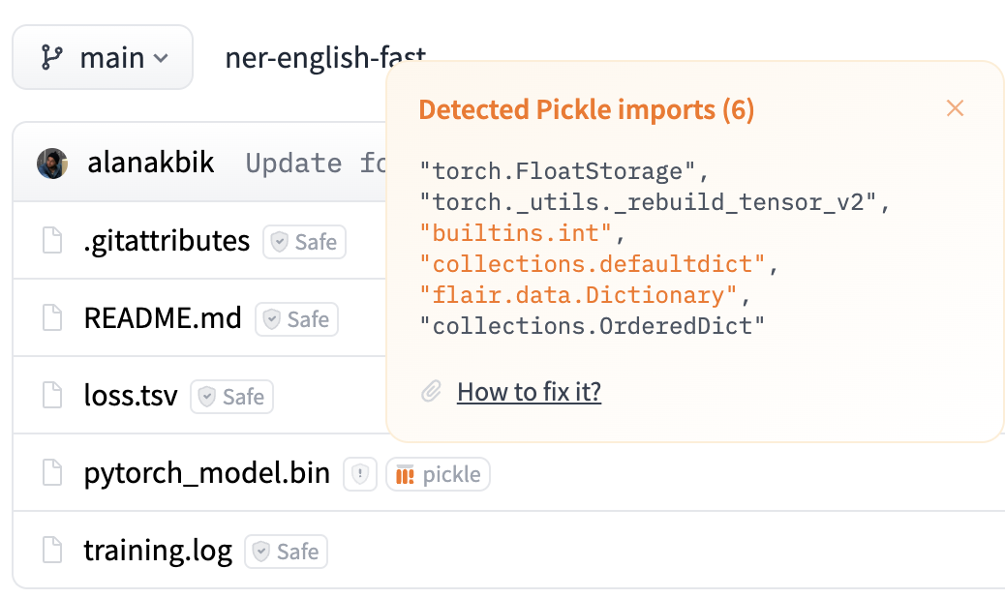
Motivating Example
flair/ner-english-fast
Model has 800k downloads in September 2025
Scanners show unrecognized imports, and can be bypassed.
Weights Only Unpickler policy cannot load this model.
The user must determine themselves if the model is safe to load. How?

Slide 64
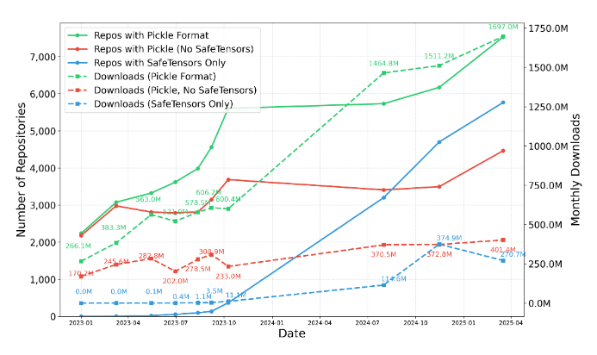
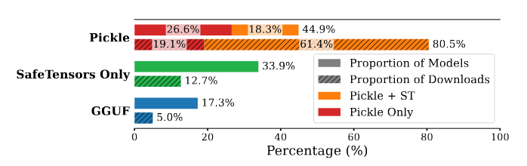
Pickle Model Ecosystem Study
March 2025 Downloads

Slide 65
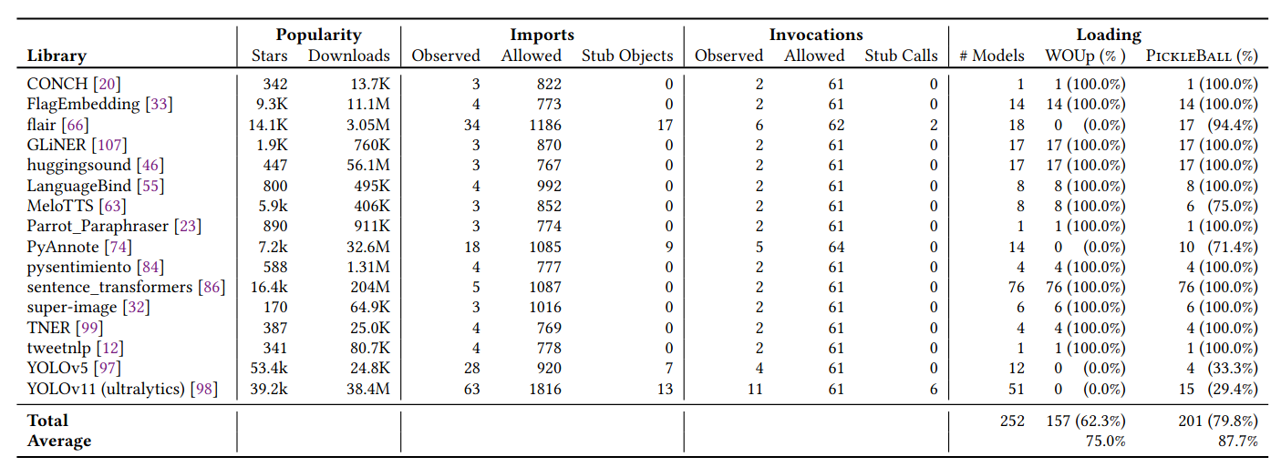
Benign Model Loading

Slide 66
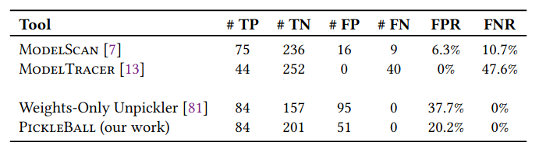
SOTA Comparison

Slide 67
The Remaining Attack Surface
PICKLEBALL permits callables by answering “could the callable appear in a benign model”?
This is sufficient to block all discovered malicious models.
Open question: can permitted callables be used in reuse-style attacks?

Slide 68
Old

Slide 69
Existing Approaches are Insufficient
Alternate formats like SafeTensors are recommended.
However, pickle model downloads are increasing.
Model scanners analyze models to identify unsafe callables.
Scanners denylists are bypassable.
Restricted loaders only permit safe callables.
Restricted loaders use conservative allowlists that often block benign models.
The Weights Only Unpickler (default in PyTorch 2.6) fails to load models from 15% of pickle model repositories.
Notes:
The dangers of pickle are known. Official Python documentation warns users not to deserialization untrusted data.
To protect the ML mode loading problem, we have some existing defenses:
Alternate formats, like Hugging Face’s SafeTensors, are recommended over pickle. These formats are less expressive, and typically only encode weight values. However, pickle is still very popular: as part of our work, we studied trends in model serialization formats over a two year period, and found that number of monthly pickle model downloads are actually increasing despite these alternate formats.
Model scanners are used to analyze models …
Restricted loaders …

Slide 70
PICKLEBALL: Policy Enforcement
Enforcement module is a modified Pickle Machine
Pickle Model
Policy Enforcement
Restricted Loader
Loaded Model
OR
Security Exception
Loading Policy
PickleBall provides a drop-in replacement for the pickle module.
Raises security exceptions when opcodes import or invoke disallowed callables.
PickleBall loads policies lazily to account for missing but unimportant callables.
When a missing callable is imported, PickleBall creates a stub object and defers raising a security exception until the stub object is invoked.
Intuition: some attributes are added to the model as metadata after instantiation. If these are not used during deserialization or inference, they do not need to be instantiated.
Notes:
PickleBall enforces a library’s policy when it is used to load a model using a library’s API.
PickleBall’s enforcement component is a modified Pickle Machine that restricts the import and invoke opcodes to respect the given policy.

Slide 71
PICKLEBALL: Policy Enforcement
Enforcement module is a modified Pickle Machine
Pickle Model
Enforces policies lazily to account for missing but unimportant callables
Policy Enforcement
Restricted Loader
Loaded Model
OR
Security Exception
Loading Policy
PickleBall provides a drop-in replacement for the pickle module.
Raises security exceptions when opcodes import or invoke disallowed callables.
PickleBall loads policies lazily to account for missing but unimportant callables.
When a missing callable is imported, PickleBall creates a stub object and defers raising a security exception until the stub object is invoked.
Intuition: some attributes are added to the model as metadata after instantiation. If these are not used during deserialization or inference, they do not need to be instantiated.
Notes:
Because the statically generated policies may be imperfect, a naive implementation blocks any models that uses a missing callable.
Sometimes, a model contain callables that are imported but not accessed during loading or inference tasks - PickleBall handles these cases with lazy enforcement, which allows loading to continue until a disallowed callable is accessed or invoked. These cases could occur when a callable represents metadata about how the model was trained, but which is not needed to load the model.

Slide 72
PICKLEBALL: Policy Enforcement
Enforcement module is a modified Pickle Machine
Pickle Model
Enforces policies lazily to account for missing but unimportant callables
Policy Enforcement
Restricted Loader
Loaded Model
Stub(“GradDescent”)
import GradDescent
OR
Security Exception
Loading Policy
PickleBall provides a drop-in replacement for the pickle module.
Raises security exceptions when opcodes import or invoke disallowed callables.
PickleBall loads policies lazily to account for missing but unimportant callables.
When a missing callable is imported, PickleBall creates a stub object and defers raising a security exception until the stub object is invoked.
Intuition: some attributes are added to the model as metadata after instantiation. If these are not used during deserialization or inference, they do not need to be instantiated.
Notes:
When a disallowed callable is imported, PickleBall does not immediately raise an exception. It creates a stub object to represent the callable, and continues loading the model.

Slide 73
PICKLEBALL: Policy Enforcement
Enforcement module is a modified Pickle Machine
Pickle Model
Enforces policies lazily to account for missing but unimportant callables
Policy Enforcement
Restricted Loader
Loaded Model
Stub(“GradDescent”)
Stub(“os.system”)
import GradDescent
import os.system
OR
Security Exception
Loading Policy
PickleBall provides a drop-in replacement for the pickle module.
Raises security exceptions when opcodes import or invoke disallowed callables.
PickleBall loads policies lazily to account for missing but unimportant callables.
When a missing callable is imported, PickleBall creates a stub object and defers raising a security exception until the stub object is invoked.
Intuition: some attributes are added to the model as metadata after instantiation. If these are not used during deserialization or inference, they do not need to be instantiated.
Notes:
[Next]

Slide 74
PICKLEBALL: Policy Enforcement
Enforcement module is a modified Pickle Machine
Pickle Model
Enforces policies lazily to account for missing but unimportant callables
Policy Enforcement
Restricted Loader
Loaded Model
Stub(“GradDescent”)
Stub(“os.system”)
import GradDescent
import os.system
invoke os.system
OR
Security Exception
Stub(“os.system”)
CANNOT BE INVOKED
Loading Policy
PickleBall provides a drop-in replacement for the pickle module.
Raises security exceptions when opcodes import or invoke disallowed callables.
PickleBall loads policies lazily to account for missing but unimportant callables.
When a missing callable is imported, PickleBall creates a stub object and defers raising a security exception until the stub object is invoked.
Intuition: some attributes are added to the model as metadata after instantiation. If these are not used during deserialization or inference, they do not need to be instantiated.
Notes:
When the stub object is accessed or invoked, an exception is raised.
This provides increased usability to load more benign models without sacrificing security.

